Slide 1

r/NBA vs r/NBADiscussion
Using classification modeling to predicted subreddits based on posts.

Slide 2
Data
We will be using top posts from two subreddits:
reddit.com/r/NBA 1000 Posts
reddit.com/r/NBADiscussions 995 Posts

Slide 3
r/NBA
r/NBADiscussion
3.6 Million Members
Created 2008
‘A subreddit dedicated for NBA news and discussion.’
110 Thousand Members
Created 2016
‘For high-quality NBA discussion.’

Slide 4

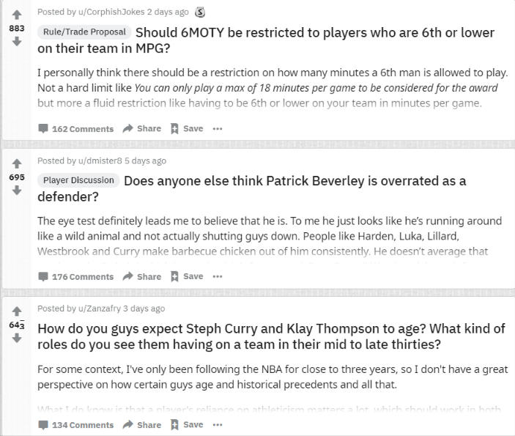
r/NBA
r/NBADiscussion
Source: https://www.reddit.com/r/nba
Source: https://www.reddit.com/r/nbadiscussion

Slide 5
r/NBA
r/NBADiscussion
1.Be civil and respectful
2.No trolling or baiting users
3.No racist, sexist, or homophobic language
4.No reposts
5.No fake news
6.No self-promotion
7.No NSFW content
8.Posts and comments must be relevant to the NBA
9.Stats/Player Tweets/Quotes/Misc. Media are self-post only and must be sourced
1.Keep it civil.
2.Submit high quality content.
3.This is a discussion subreddit. Support claims with substantiated arguments.
4.Vote based on if the post or comment meets the standard of quality you expect from this subreddit.
5.No spam.
6.Attack the argument, not the person.
7.Most arguments can't be deconstructed in a sentence. Top level comments have a char. minimum of 100
8.Present descriptive, clear, and concise titles.
9.Present your own argument.
10.Posts like "Thoughts?" or "Discuss" are low effort and will be removed.
11.Post enough content to provide a jumping-off point. The char. minimum for posts is 350.

Slide 6
Word Count and Character Length
 | Title |  | Body
 | Mean Word Count | Mean Character Length | Mean Word Count | Mean Character Length
NBADiscussion | 14.82 | 85.42 | 459.24 | 2850.18
NBA | 19.96 | 109.59 | 40.25 | 328.38
Note:
73.1% of NBA post’s bodys are empty compared to only 3.92% of NBADiscussion post’s.

Slide 7
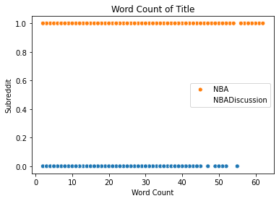
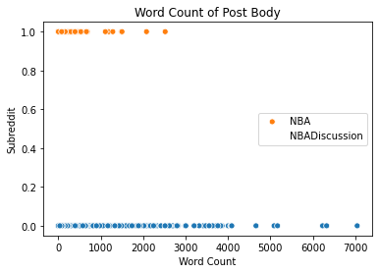
Scatterplot Of Word Counts

Slide 8
Punctuation
 |  | Question Mark | Exclamation Point | Period
Title | NBADiscussion | 39% | 0.80% | 23.80%
 | NBA | 5.10% | 4.50% | 44.70%
Body | NBADiscussion | 60.70% | 12.90% | 95.78%
 | NBA | 10% | 4.20% | 25.80%

Slide 9
Created Columns
title_length - character length of the title of each post
title_word_count - word count of the title of each post
body_length - character length of the body of each post
body_word_count - word count of the body of each post
title_question_mark - binary number indicating whether the title has a question mark or not
body_question_mark - binary number indicating whether the body has a question mark or not
title_exclamation_mark - binary number indicating whether the title has a exclamation mark or not
body_exclamation_mark - binary number indicating whether the body has a exclamation mark or not
title_period -binary number indicating whether the title has a period or not
body_period - binary number indicating whether the title has a period or not

Slide 10
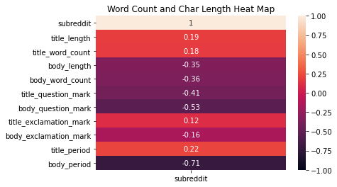

Slide 11
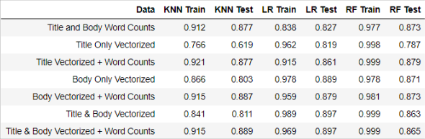

Slide 12
r/NBA
r/NBADiscussion
Feature | Odds
! | 1.871886
edit | 1.835068
'' | 1.69364
behind | 1.577843
`` | 1.568591
melo | 1.519526
series | 1.500071
city | 1.488503
tell | 1.477327
your | 1.472208
back | 1.461715
from | 1.461193
lebron | 1.426954
off | 1.425855
j. | 1.401065
highlight | 1.371397
charania | 1.366341
... | 1.358571
ticket | 1.357091
jackson | 1.348255
Feature | Odds
? | 2.538367
think | 2.160937
pick | 1.9235
team | 1.690012
future | 1.598005
coach | 1.588913
thunder | 1.568557
report | 1.556737
heat | 1.526363
if | 1.506813
but | 1.496509
g-league | 1.481034
khris | 1.475909
all-star | 1.472827
middleton | 1.472078
discussion | 1.467017
who | 1.466202
grunfeld | 1.465943
an | 1.450438
inside | 1.450404

Slide 13
Key Takeways
We were able to create multiple models to differentiate r/NBA from r/NBADiscussions.
The Logistic Regression Model had the highest accuracy score on testing data (.904).
Keeping punctuation in the data set improved accuracy.
Question marks increased odds towards NBADiscussion
Exclamation marks increased odds towards NBA
Removing common words actually decreased accuracy scores.
Word counts in the post’s body were highly correlated with each subreddit, larger word counts were more likely to be found in NBADiscussion

Slide 14
Further Research
Sentiment analysis of each subreddit
Study vocabulary used in each subreddit
Study vectorized data again but account for word count

